Slide 1
Week 7 Synchronous Session

Slide 2
Agenda
Logistics
Week 5 Homework Assignment
Week 6 Quiz
Week 6 In-Module Exercises
Time to do some coding together!

Slide 3
Logistics
State of the world is horrifying and it’s hard to focus. So:
2 additional 24-hour homework extensions (on top of the 2 you already have)
Homework deadline this week extended to FRIDAY EVENING at 11:55 PM
Let me know if you need more than that
Please take care of yourselves!

Slide 4
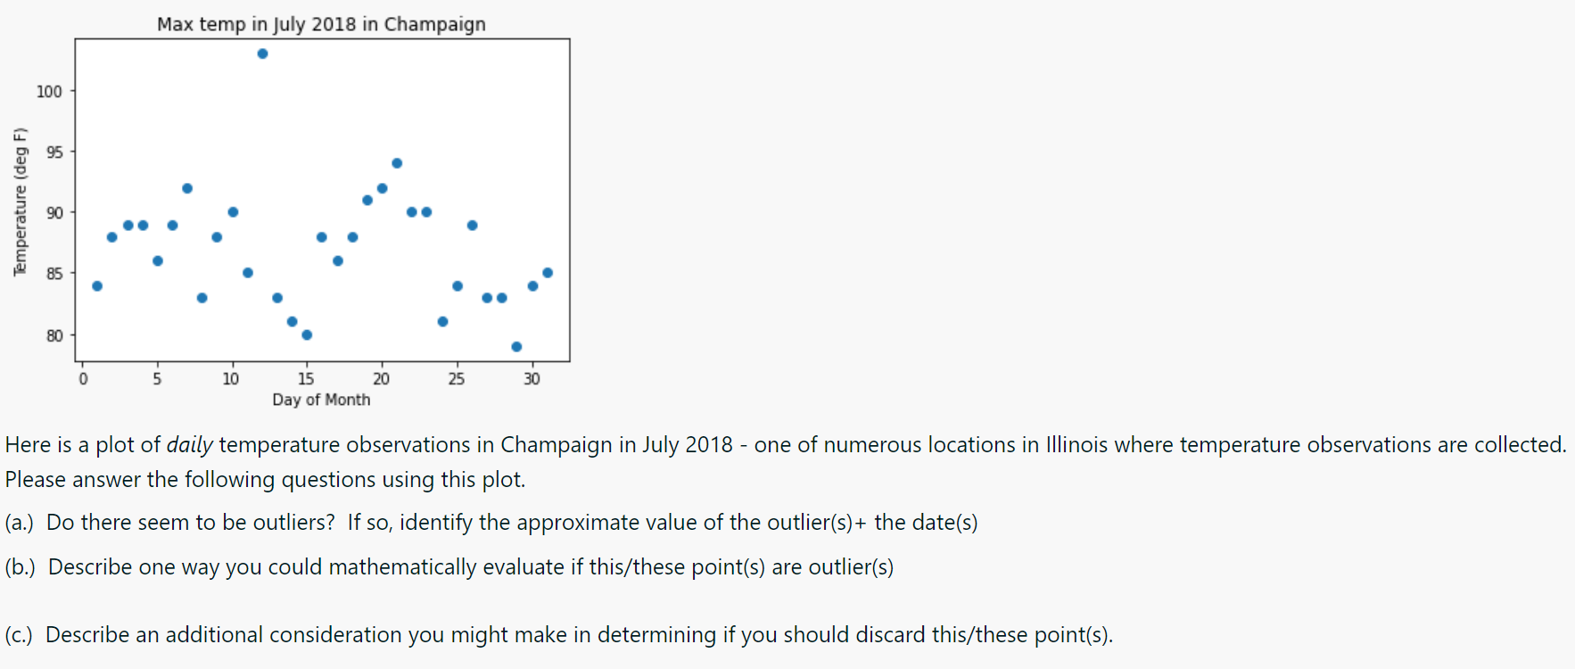
Week 6 Quiz

Slide 5
Week 6 Quiz
What was the low temperature this day?
What were temperatures like at nearby stations this day?
What does other weather data from Champaign look like on this day?
Generally speaking, physical considerations – could this be an extreme event?

Slide 6
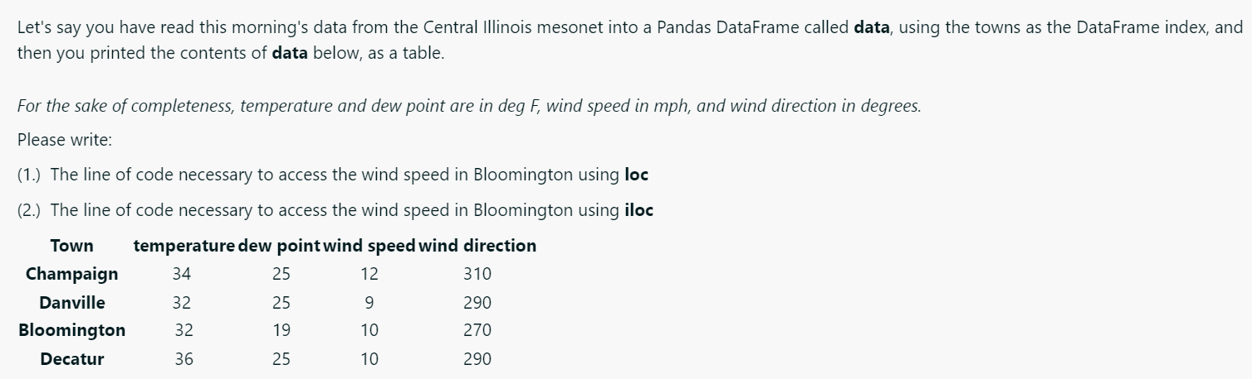
Week 6 Quiz
How would I number these rows and columns?

Slide 7
Week 6 Quiz
0 1 2 3
0 1 2 3

Slide 8
Week 6 Quiz
(1.) data.loc[‘Bloomington’, ’wind speed’]
LABEL-BASED INDEXING
(2.) data.iloc[2,2]
POSITIONAL-BASED INDEXING (LIKE IN NUMPY)
0 1 2 3
0 1 2 3

Slide 9
Week 6 Quiz
Merging vs. grouping
Merging: combining/concatenating data structures
Grouping: sub-setting data by certain criteria, allowing for more meaningful statistical and other calculations
Pandas and Xarray – why so important?
Packages with clever functionality, plotting-interfaces, etc. tuned for text-based data (Pandas) and binary (often spatial) data (Xarray)
Label-based indexing! (NumPy – position-based indices!)
Xarray – no longer need to keep track of order of dimensions!

Slide 10
Week 5 Assignment Solution
Key principles
Index slicing – not inclusive of upper end
Transform argument!
Wise choice in colormaps
Units, units, units!

Slide 11
Week 6 In-Module Exercises
Key principles
Accessing specific columns in Pandas (Q4)
Many Pandas functions – inplace = True, or set to a new variable, else changes not actually saved to your data structure! (Q5,Q7)
Max, min in Pandas – can specify numerical columns only!
Use Pandas NaN tools!

